Slide 1

Lead Scoring Case Study
A comprehensive analysis of lead conversion optimization for X Education, an online education company serving industry professionals. This case study demonstrates how data-driven lead scoring can transform a 30% conversion rate into an 80% success story through strategic identification of "Hot Leads" and targeted sales efforts.
Submitted by: Atharv Awasthi

Slide 2
The Challenge: Converting More Leads
Current State
The Goal
X Education faces a common industry challenge: while many professionals visit their website and fill out forms to become leads, only about 30% ultimately convert to paying customers. With hundreds of leads generated daily, the sales team struggles to prioritize their outreach efforts effectively.
The CEO has set an ambitious target: achieve an 80% lead conversion rate. To reach this goal, X Education needs a sophisticated lead scoring model that assigns each lead a score between 0-100, enabling the sales team to focus their energy on the most promising prospects.
The company's sales process involves multiple touchpoints—calls, emails, and follow-ups—but without a systematic way to identify which leads are most likely to convert, resources are spread thin across all prospects equally.
Additionally, the model must be flexible enough to handle future business constraints, including peak time resource allocation, manpower optimization, and post-target achievement strategies.

Slide 3
Strategic Approach to Model Building
01
02
03
Data Import & Cleaning
Exploratory Data Analysis
Feature Engineering
Import raw data and handle null values, outliers, and remove columns with high percentages of missing data to ensure data quality.
Analyze variable behavior patterns and select the most contributing attributes through comprehensive univariate and multivariate analysis.
Perform train-test split, scale features appropriately, and use RFE (Recursive Feature Elimination) to select optimal features for model building.
04
05
Model Development
Scoring & Validation
Build logistic regression model with manual tuning to achieve p-value < 0.05 and VIF < 5, ensuring statistical significance and minimal multicollinearity.
Predict on train set, assign lead scores based on ROC curve threshold, evaluate parameters, then test on holdout set for validation.

Slide 4
Data Preparation: Cleaning for Clarity
Rigorous data cleaning was essential to build a reliable predictive model. The dataset required multiple preprocessing steps to ensure quality and relevance:
Handling Missing Values
Removing Irrelevant Data
The "Select" level represented null values where users didn't choose any option. Columns with over 40% null values were dropped entirely. Missing values in categorical columns were handled based on value counts and distribution patterns.
Dropped columns that didn't add insight to the study objective, including 'City', 'Tags', 'Country', and 'What matters most to you in choosing a course'. Also removed identifier columns like 'Prospect ID' and 'Lead Number' not needed for modeling.
Treating Outliers
Standardization
Outliers in 'TotalVisits', 'Total Time Spent on Website', and 'Page Views Per Visit' were treated and capped to prevent skewing the model. Numerical data was imputed with mode after checking distribution patterns.
Standardized data in columns by checking casing styles (e.g., "Lead Source" had both "Google" and "google"). Low frequency values were grouped together as "Others". Binary mapping was performed for well-distributed categorical columns.

Slide 5
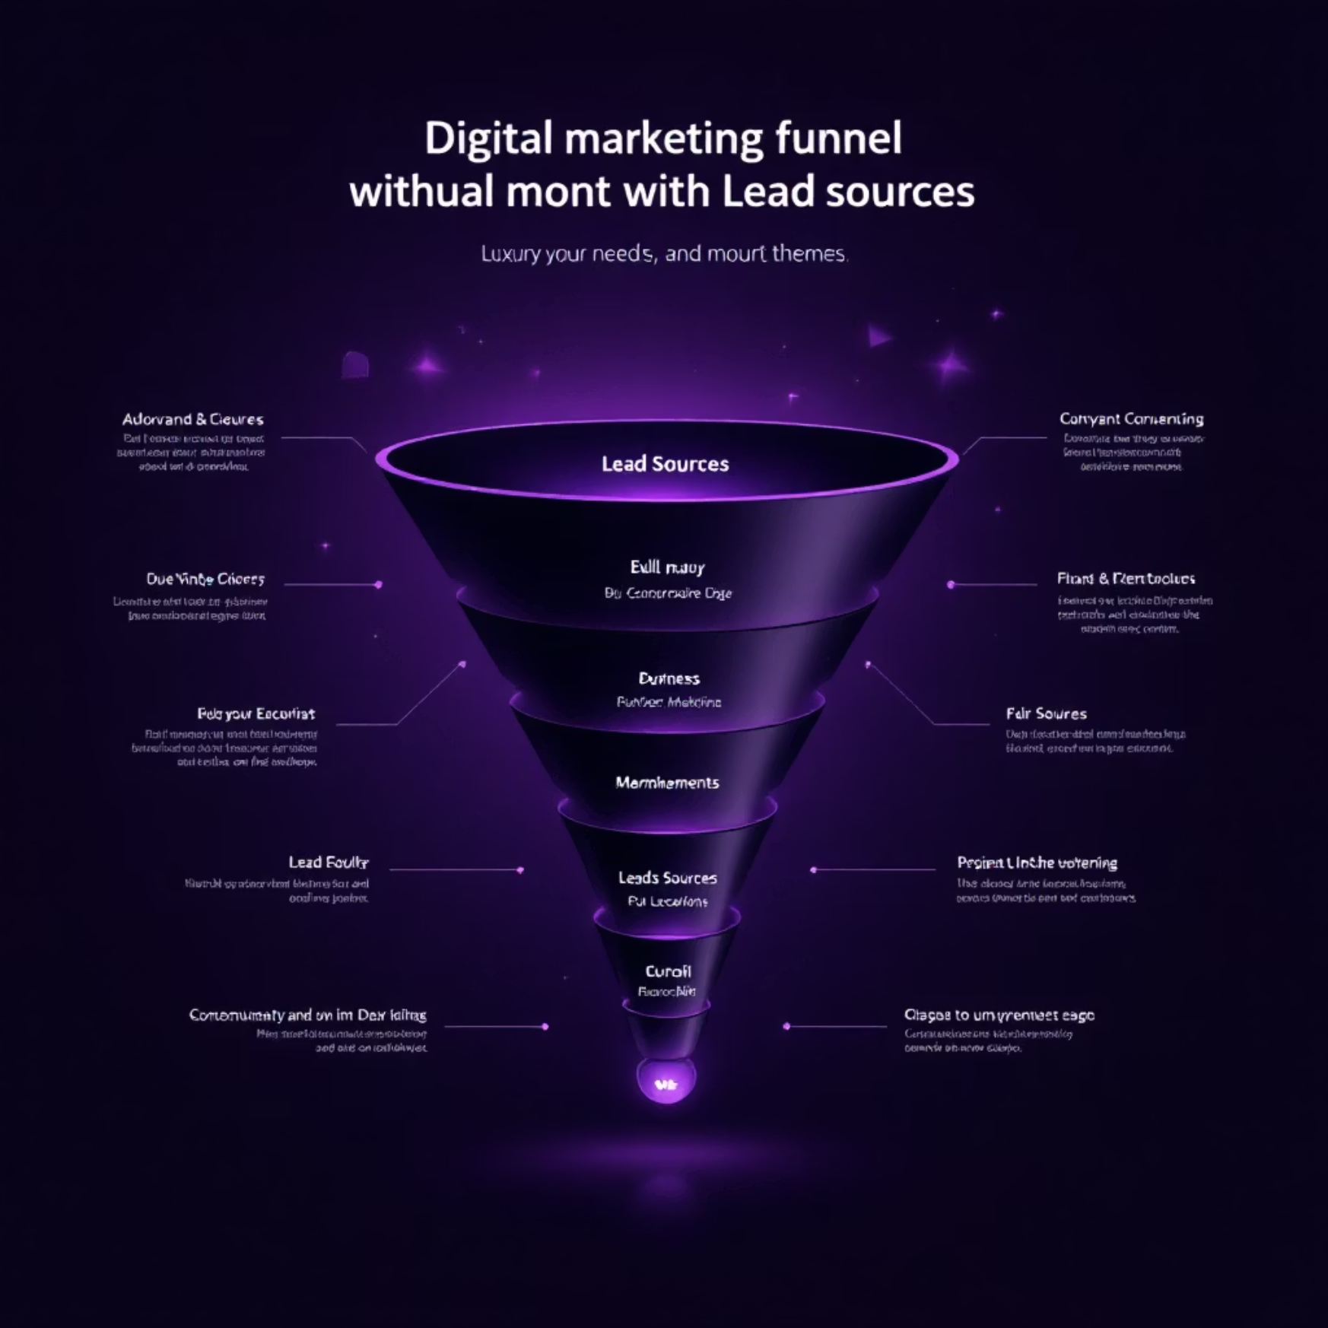
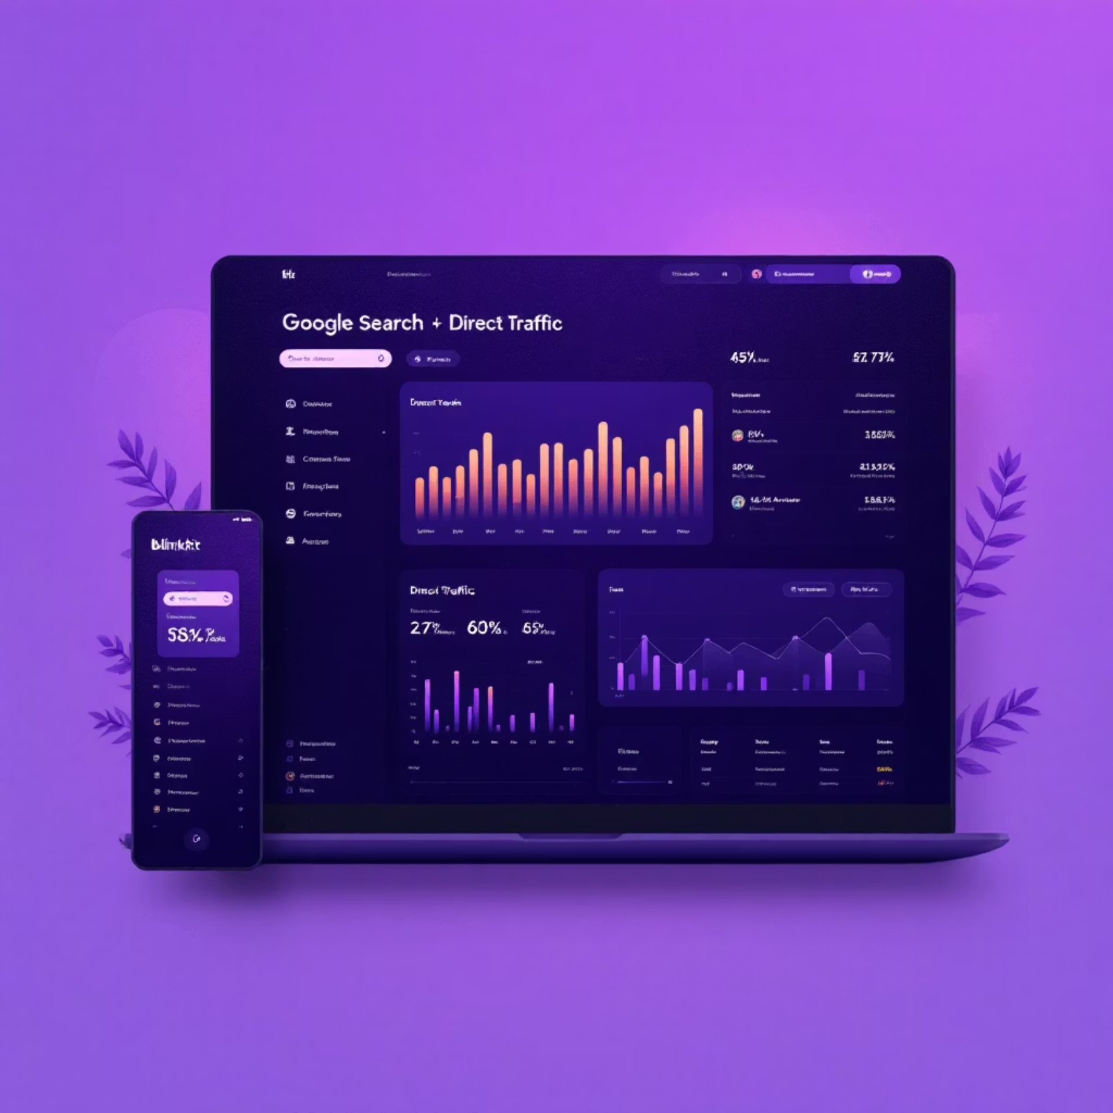
Key Insights: Lead Origin & Source Analysis
Lead Origin Performance
Lead Source Breakdown
API and Landing Page Submission: 12.4-19.2% conversion rate with considerable lead volume
Google and Direct Traffic: Maximum lead generation with 30-35% conversion rate
Lead Add Form: Good conversion rate but lower lead count
Reference and Welingak Website: Highest conversion rates
Lead Import: Very low count overall
Other Sources: Negligible contribution beyond top 5-6 categories
Strategic Focus: Improve conversion of API and Landing Page Submission origins while generating more leads from Lead Add Form.
Strategic Focus: Improve conversion of Olark chat, organic search, direct traffic, and Google leads. Generate more leads from reference and Welingak website.

Slide 6
Behavioral Patterns: Activity & Occupation
Last Activity Analysis
Current Occupation Insights
Last Notable Activity
Most leads have "Email Opened" as their last activity with approximately 35% conversion rate. Email Opened and SMS Sent categories contain the majority of leads. SMS Sent leads show almost 60% conversion rate—the highest among all activities.
Working Professionals pursuing courses have high conversion likelihood. Unemployed leads are most numerous with 30-35% conversion rate. Students show lower conversion rates overall.
Modified, Email Sent, and Email Opened hold maximum share of leads. SMS Sent has highest conversion rate, followed by Email Opened and Modified categories.
Recommendation: SMS-sent leads must be prioritized for follow-up to increase conversion rate significantly.
Recommendation: Prioritize Unemployed customers first, then Working Professionals. This approach will increase efficiency and maximize productivity.
Recommendation: Focus heavily on these two categories to improve overall lead conversion, as other categories show poor conversion rates.

Slide 7

Engagement Metrics: Time & Interaction Patterns
Analysis of numerical variables revealed critical insights about lead behavior and conversion likelihood:
Total Visits vs. Conversion
Page Views Per Visit
Time Spent on Website
Shows comparable numbers of converted and unconverted leads. Higher visit frequency correlates with increased page views per visit, indicating engaged prospects.
Similar to total visits, this metric shows balanced distribution between converted and unconverted leads, suggesting it's a moderate predictor when combined with other factors.
Most significant predictor: Shows considerably more converted leads compared to unconverted. Higher time spent directly correlates with higher conversion probability.
Key Finding: There is a strong positive correlation between 'Total Visits' and 'Page Views per Visit'. More importantly, customers who spend more time on the website have a higher lead conversion rate, indicating that increasing website engagement time can lead to higher conversion rates.

Slide 8
Model Performance: Exceptional Results
78.3%
Model Evaluation Details
Model evaluation was carried out using a Confusion Matrix with a cutoff point of 0.36 suggested by the ROC curve analysis. The precision-recall trade-off yielded optimal results with a cut-off of 0.41:
Accuracy
Overall model accuracy on test set
Precision score: 0.70
Recall score: 0.7962
83.6%
The Area under ROC for both train and test datasets is 0.86, indicating that the model is an excellent predictor. The curve plotted close to the top left corner of the plot indicates that the model has a high true positive rate and a low false positive rate at all threshold values.
Sensitivity
Critical Success: The model maintains consistent performance across train and test sets, demonstrating strong generalization capability without overfitting.
True positive rate (recall)
75.2%
Specificity
True negative rate
0.86
ROC AUC
Area under ROC curve

Slide 9
Actionable Conclusions: Prioritizing Hot Leads
The model identified 434 hot leads that require immediate contact. Here are the key strategic conclusions for maximizing conversion rates:
Time on Website
Lead Origin Priority
Prioritize leads who spent more time on the website—these are significantly more likely to convert. This is the strongest predictor of conversion success.
Focus on leads from "Lead Add Form" origin as they are highly likely to convert. Avoid leads from "Landing Page Submission" as they show poor conversion rates.
Lead Source Focus
Activity-Based Targeting
Prioritize leads from "Welingak Websites" and "Olark Chat" sources—these demonstrate the highest conversion likelihood among all sources.
Contact leads whose last notable activity was "SMS Sent" and "Others" first. Avoid leads with "Olark chat conversation" and "Email bounced" as last activity.
Engagement Metrics
Specialization Insights
Prioritize leads with higher total visit numbers—increased engagement correlates strongly with conversion probability.
Focus on leads with specialization in "Finance Management", "HR Management", "Marketing Management", and "Operation Management". Avoid leads with "Others" specialization.

Slide 10

Strategic Recommendations for Sustained Growth
Beyond the immediate lead scoring implementation, these strategic recommendations will help X Education maintain and exceed the 80% conversion rate target:
Enhanced Advertising
Automated Engagement
Chatbot Integration
Make advertisements on "Welingak Websites" and "Olark Chat" more interesting and engaging, as these sources generate the highest-converting leads.
Implement automated responses or GenAI support for customers who spend more time on the website. Understand their interest areas and provide tailored information accordingly.
Deploy user-friendly chatbots to increase communication effectiveness and attract more customers through improved engagement experiences.
Specialization Focus
Referral Incentives
Acquire more data on specializations to offer tailored courses. Focus on Finance, HR, Marketing, and Operations Management where conversion rates are strongest.
Provide more incentives and offers for referral benefits to attract additional customers through word-of-mouth marketing.
Final Impact: By implementing this lead scoring model and following these strategic recommendations, X Education is positioned to achieve and sustain the CEO's target of 80% lead conversion rate while optimizing resource allocation and maximizing sales team productivity.

